Slide 1

Term Project: US Police Shootings
By: Zach Stept

Slide 2
Data
For more info and for source: https://www.kaggle.com/ahsen1330/us-police-shootings

Slide 3

Break Down of Dataset
Each row is specific to an individual person and is based on the facts of each shooting.
This dataset contains all 4,895 shootings from 2015 to mid-2020.
This dataset only contains information related to police shootings. Deaths like George Floyd are not police shootings (death by police brutality) and thus are not a part of this dataset.

Slide 4
Columns of the Dataset
ID
Name
Date
Manner of death
Armed
Age
Gender
Race
City
State
Signs of mental illness
Threat level
Flee
Body camera
Arms category

Slide 5
Code Package
For more info and for source: https://cran.r-project.org/web/packages/ggplot2/ggplot2.pdf

Slide 6
ggplot2
This package is part of the tidyverse package and is used for basic graphing.
The package is also referred to as the grammar of graphics.

Slide 7
Code

Slide 8

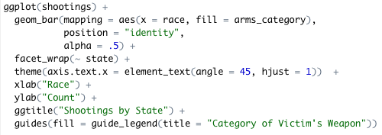

Slide 9
Break Down of Code
The features I used from this package:
geom_bar: creates a bar graph from a chosen x variable; the y variable is not needed because it automatically counts the frequency in each category of the x variable
fill: colors in the bars using categories from a chosen categorical variable
position = “identity”: overlaps each category in the x variable instead of stacking them or placing them side by side
alpha = changes the transparency of the bars from 0 to 1
facet_wrap: turns 1 graph into multiple graphs based on a chosen variable
theme: rotates the position of the x variable categories in order to better see the words
xlab, ylab, ggtitle, and guides: changes the name of the x-axis, y-axis, title, and legend labesl

Slide 10
Goals

Slide 11
Break Down of Goals
The goals of this project is to determine which race is mostly affected/killed by police.
In order to better determine which race is mostly affected/killed, I broke it down by state.
We can also see which type of arms was used most by each race.

Slide 12
Visualization

Slide 13
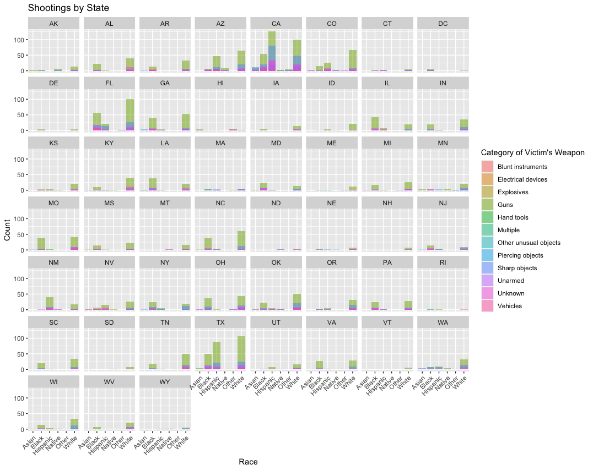

Slide 14
Break Down of Visualization
From looking at the visualization/graph, we can see that the races that are affected the most are Hispanics and Whites.
The states that have the most shootings are California, Georgia and Texas.
The most common weapon of the victim in these shootings are guns. However, sharp objects are also common.

